Slide 1
Zain 21-Arid-482
Presented by:
Rohan 21-Arid-470
Usama 21-Arid-527
COAL Presentation

Slide 2
Instruction Cycle
Program is a collection of statement.
Statement is fetched and executed.
Pc contains address of next instruction
Value of operand is fetched.
Cpu performs operations
Cpu stores results

Slide 3
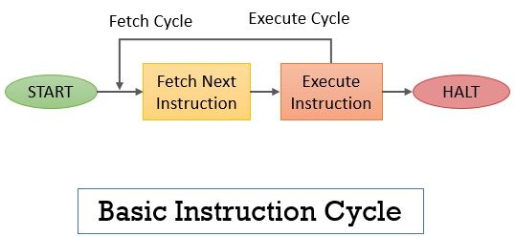
Instruction cycle
Diagram:

Slide 4
Indirect Cycle
Additional memory access is required if indirect addressing is used in the instructions
This adds one more stage or cycle to the basic instruction cycle.
Basically, the instruction fetch and instruction execute cycle occurs alternatively.
If indirect addressing is present the operands are fetched by performing an indirect cycle
And if there occurs an interrupt it is processed before the execution of the next instruction

Slide 5
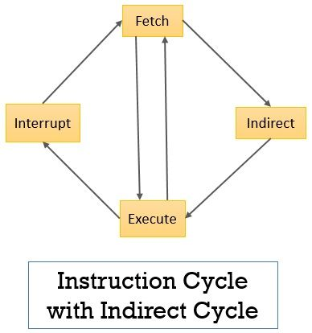
Indirect Cycle
Diagram:

Slide 6
Data Flow
The structure of the instruction cycle varies from processor to processor depending on its design.
Generally it is used for two purposes:
To assist and clarify the thinking process of the programmer.
communicate his thoughts and knowledge to others.

Slide 7
Data Flow
Memory Address Register (MAR): This register holds the address of memory location from where the data has to be fetched or to where the data has to be stored.
Memory Buffer Register (MBR): This register stores the data that is either fetched from the memory or that has to be stored in the memory.
Program Counter (PC): This is also called the instruction address register as it holds the address of the instruction that has to be executed next.
Instruction Register (IR): This register holds the instruction that has to be interpreted.

